Slide 1
Introduction of new Workflows in Renku CLI 1.0

Slide 2

Previously on renku

Slide 3
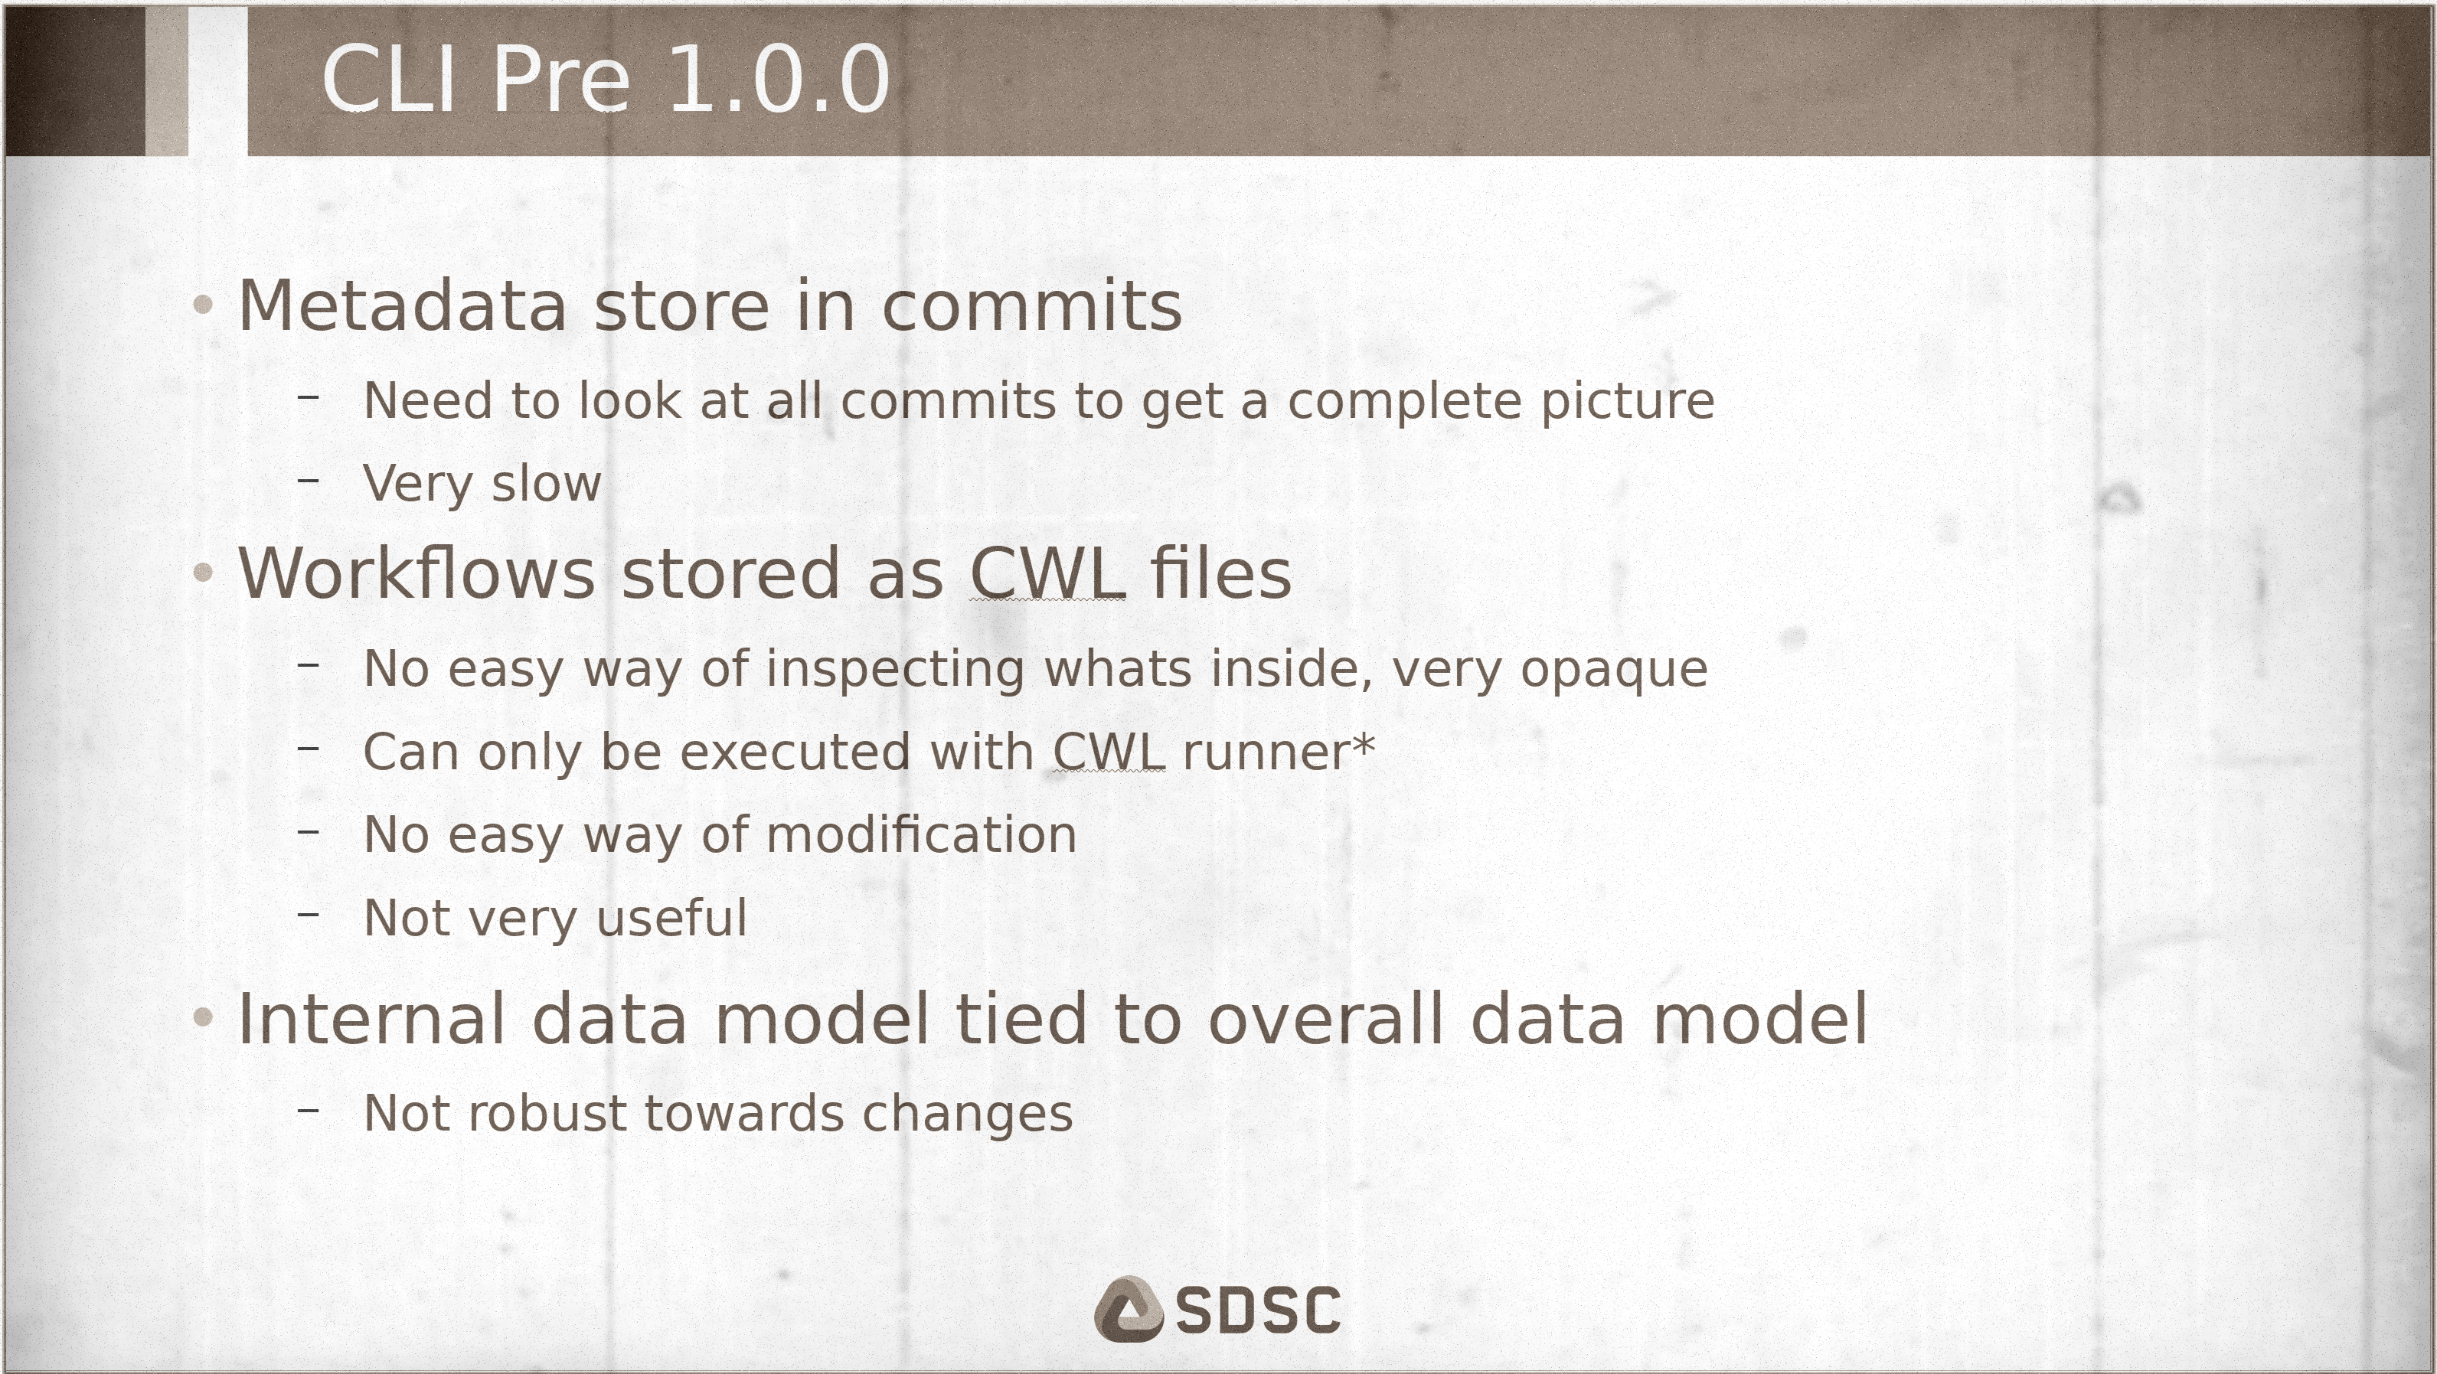
CLI Pre 1.0.0
Metadata store in commits
Need to look at all commits to get a complete picture
Very slow
Workflows stored as CWL files
No easy way of inspecting whats inside, very opaque
Can only be executed with CWL runner*
No easy way of modification
Not very useful
Internal data model tied to overall data model
Not robust towards changes

Slide 4
And now!

Slide 5
Improvements
Metadata stored in HEAD commit
Immediately available
Single source of truth
Data model gets transformed to Knowledge Graph
Free to change internal metadata without breaking things
Workflows full stored in Renku format
Can be inspected, reused, modified, exported, etc.
Makes provenance useful beyond knowing what has happened

Slide 6
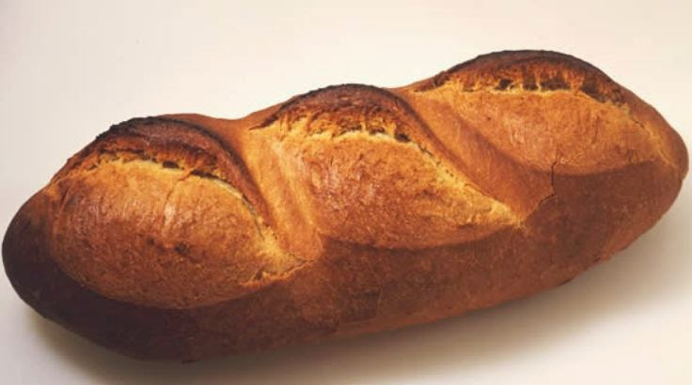

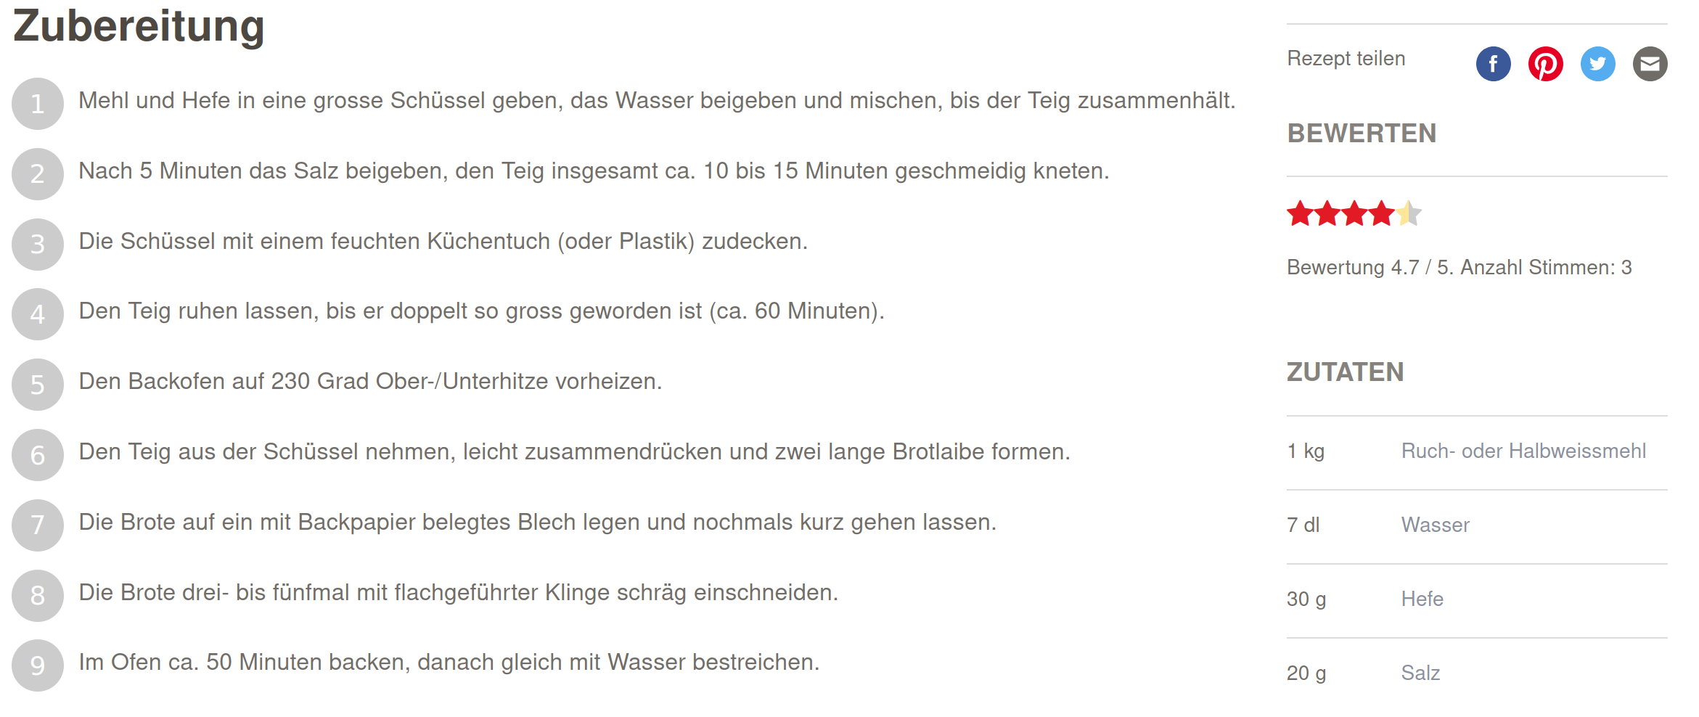
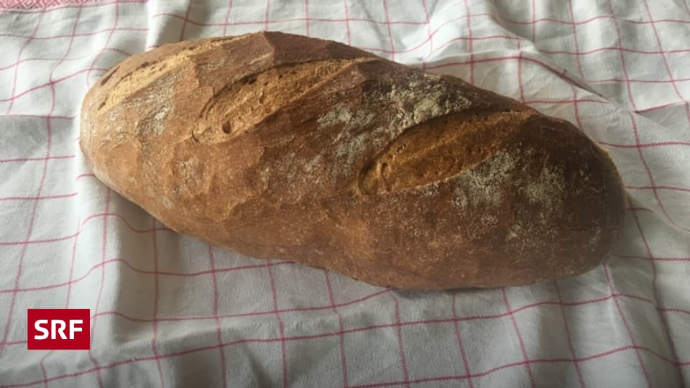
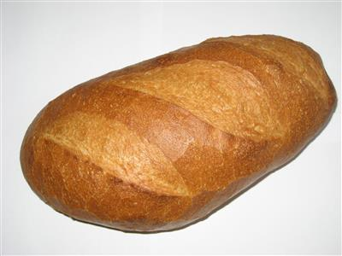
Activities and Plans
Activity
Plan
https://schweizerbrot.ch

Slide 7
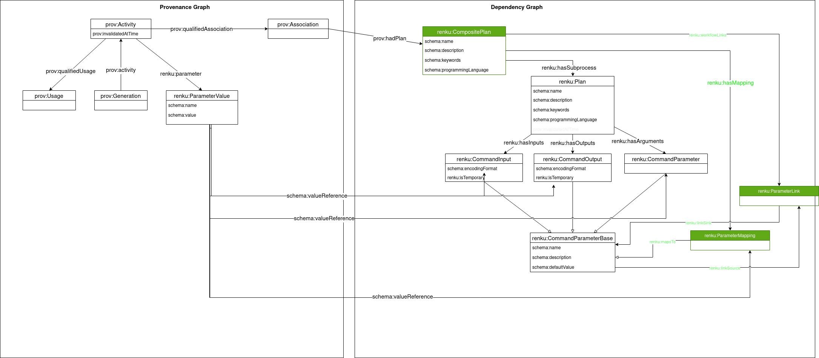
Under the Hood

Slide 8
Commands
renku run --name my-plan -- <command>
Execute <command>, creating a Plan named my-plan
renku workflow ls
Show Plans
renku workflow compose new-plan-name plan1 plan2 …
Compose Plans together into bigger plans
renku workflow execute --provider toil … my-plan
Execute a workflow using a provider plugin
renku workflow iterate --map … my-plan
Execute a workflow repeatedly with differing values
renku workflow visualize <path>
Show a graph of how <path> was created

Slide 9
Renku on HPC
Install toil plugin
pip install renku[toil]
Create a config for Slurm, e.g. config.yaml
Execute the workflow
TOIL_SLURM_ARGS="-A my_account --export=ALL" renku workflow execute -p toil -c config.yaml my_plan
More details at https://renku.readthedocs.io/projects/renku-python/en/latest/how-to-guides/hpc.html

Slide 10

Hands on
https://github.com/Panaetius/renku-cli-1.0.0-presentation

Slide 11
Questions?
renku workflow execute --provider Ralf answer-questions

